Slide 1

Companion – TEPEZZA Feedback Root Cause Analysis (May’24)
June 18, 2024

Slide 2
Agenda
User Feedbacks
Resolved Issues with Latest Architecture
Issues with Examples
New architecture resolved the issue
Response Improvisation Instances
Issues which need to worked On
Issues with examples
Root Cause Analysis & Solution
Feedback - Need discussion with Medical Affairs Team

Slide 3

Feedbacks from TEPEZZA BU
Positive
Constructive
The study outcomes were provided before the study groups which was the answer to the question being asked.
Most of the answer describes treatment rather than the description of the patient
The information mentioned TAO. and we address it as TED- this may lead to confusion-
Is there a way to harmonize the lexicon and have it explain that thyroid eye disease has many other ways in which it is named / referenced ( TED, TAO, GO)
The question was asking for the number of patients that were included in the OPTIC trial. The answer I was expecting was 51 (i.e. 37 OPTIC placebo patients who received their first course of TEPEZZA were included/enrolled in OPTIC-X and 14 second course OPTIC teprotumumab group were included/enrolled in the OPTIC-X). Companion's response was the number of patients that completed the study
The question asked about patients that did not complete the treatment - the answer did not specify
I would like to have seen a definition of regression and then the objective answer
This is vague. I think the person seeking information would still need to just go to the original reference to get any applicable detail.
EUGOGO is a good source for this response and should be included. Also the last response Preferred Therapeutic Option for Moderate-to-Severe TED is not relevant to this question.
Companion provided primary and secondary from the OPTIC-X trial. It also cited the OPTIC-X trial, where as the question requested for the primary and secondary endpoints of the OPTIC trial. Not sure if it picked up OPTIC from the previous question about OPTIC-X and so it was searching the OPTIC-X article for answers
The references cited (other than the guidebook) are for the most part consistent with reference I cite for this topic. Wang Y, et al. Ther Clin Risk Manag. 2019;15:1305–1318 and maybe also the ATA/ETA consensus statement, EUGOGO Guideline are also a good resource for discussion on TED treatment modalities.
The reference 1 is for the Optic-x study. Should use Douglas reference for the optic study.
This time it seemed to pick information from OPTIC-X (the phase 3 extension) instead of OPTIC which is the phase 3 study
The purpose of treating TED is not to achieve euthyroidism - it is to treat Thyroid Eye disease
I asked about the use of Tepezza in patients with liver failure- it did not answer my question
The first part of this answer is not for OPTIC-X. It looks like it was for OPTIC.
Drew from OPTIC rather than OPTIC-X
this answer is wrong
The answer provides some relevancy. Needs more information about Recurrence of TED. Should be using reference on 'Recurrent Thyroid Eye Disease'.
References should include phase3/4 publications to elaborate on the AE's from both acute and chronic studies.
The response does not provide details of the complications caused by steroid use in TED.
Issues resolved with current architecture
Proposed solution for the Issues
Need additional details from Med-Affairs Team
Constructive feedbacks have been further categorized into three; Issues resolved with current architecture, Proposed solution for the Issues, and Need additional details from Med-Affairs Team

Slide 4


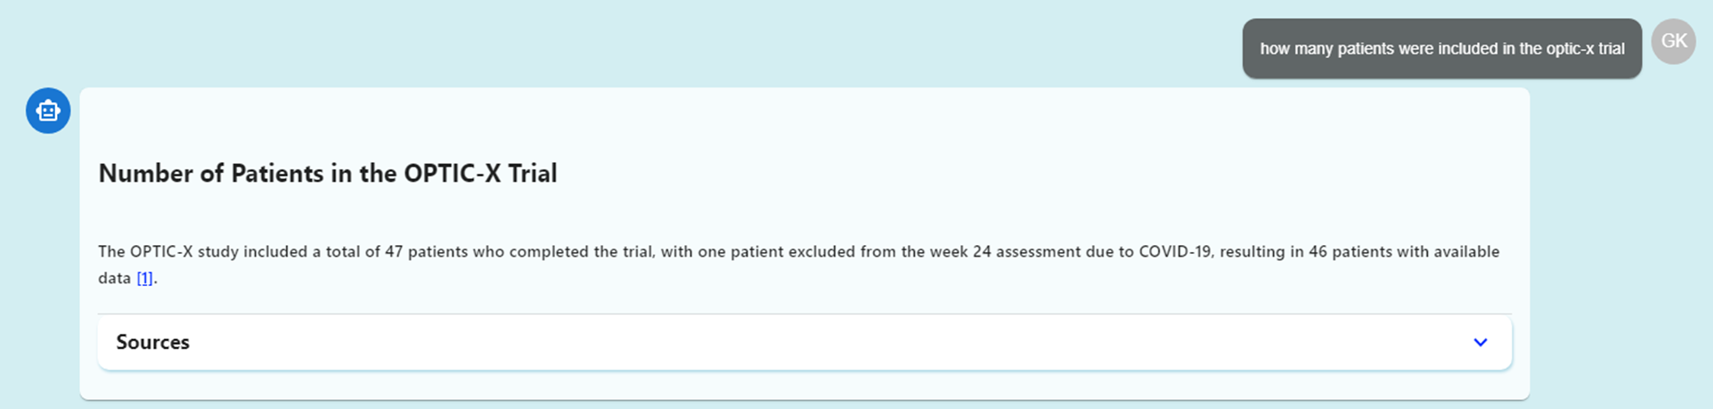
Resolved Issues with Latest Architecture – Example 1
User Comment
Problem Identified
The question was asking for the number of patients that were included in the OPTIC trial. The answer I was expecting was 51 (i.e. 37 OPTIC placebo patients who received their first course of TEPEZZA were included/enrolled in OPTIC-X and 14 second course OPTIC teprotumumab group were included/enrolled in the OPTIC-X). Companion's response was the number of patients that completed the study
Numerical answers are incorrect
Prompt engineering for numerical answers need to be enhanced

Slide 5

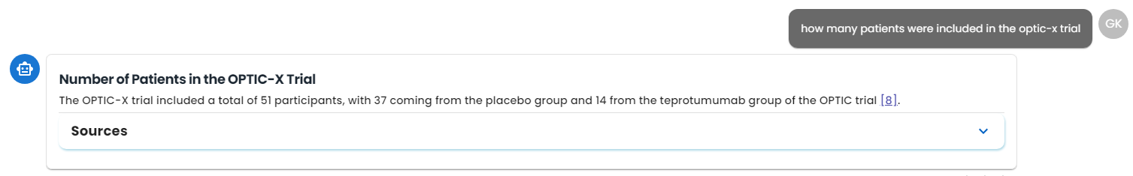
Response Improvisation Instances (1/4)
Old Architecture
New Architecture

Slide 6
Need discussion with Medial affairs for more clarity on Feedbacks
User Comments | Details Required
The answer provides some relevancy. Needs more information about Recurrence of TED. Should be using reference on 'Recurrent Thyroid Eye Disease'. | Need specific document and the content being referred here for Recurrent Thyroid Eye Disease
The response does not provide details of the complications caused by steroid use in TED. | Reference needed about the effects of steroid on TED
References should include phase3/4 publications to elaborate on the AE's from both acute and chronic studies. | The response appears to be decent technically Reference of additional info required to be displayed
Noticed it mentioned Minnesota- I understand why it was mentioned, but it can be distracting- what about patient outside Minnesota? - Also not comprehensive in its description | Response seems good "Minnesota" seems to appear, probably due to the research outcomes conducted in the place? Specific Reference of the document could help us understand better
Picked information from Chronic Case study from Ugradar but not from Phase 4 trial (perhaps not picked up due to terminology used in that paper- can we "broaden" that?). The information from Ugradar was picked from the Discussion of the Phase 4 trial paper. Also picked text from discussion of another paper, and did not summarize data | One of the Phase 4 chunk appeared in sources; but didn’t find much details regarding the chronic disease; Need specific content/document which need to be present in the response
Link:

Slide 7
Agenda
User Feedbacks
Resolved Issues with Latest Architecture
Issues with Examples
New architecture resolved the issue
Response Improvisation Instances
Issues which need to worked On
Issues with examples
Analysis & Solution
Feedback - Need discussion with Medical Affairs Team

Slide 8
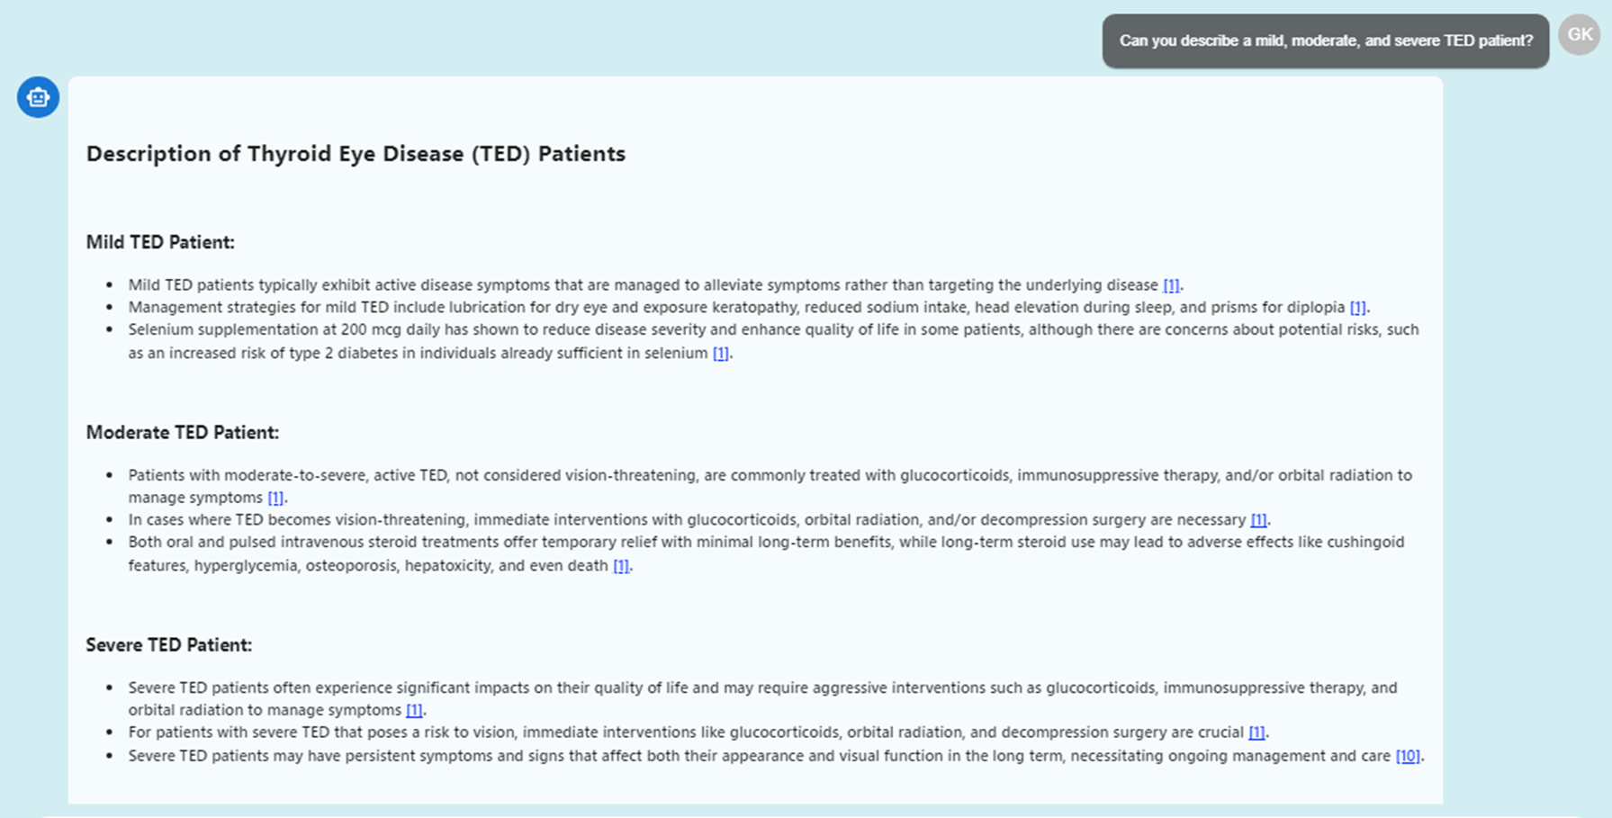
Example 2
User Comment
Problem Identified
Most of the answer describes treatment rather than the description of the patient
Answer is incorrect - Asked for patient description but given treatment description

Slide 9
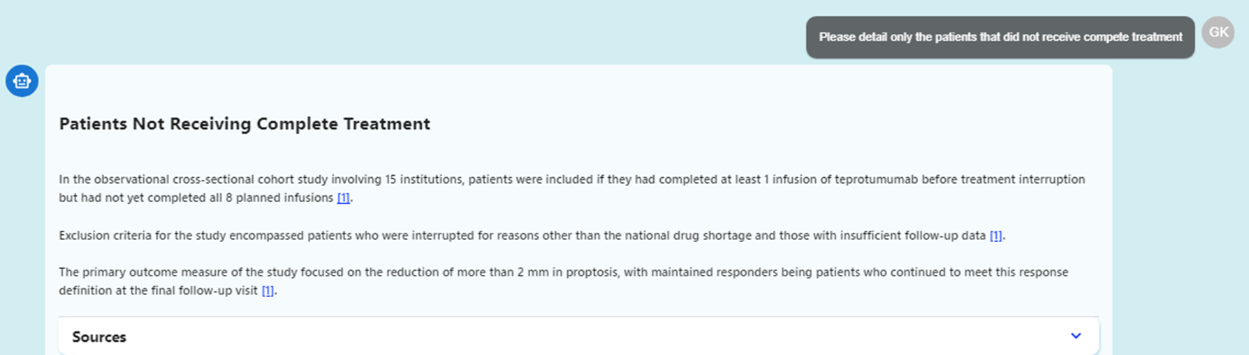
Example 3
User Comment
Problem Identified
The question asked about patients that did not complete the treatment - the answer did not specify
Specificity is not there in answer

Slide 10
New architecture resolved the issue
Old Architecture
New Architecture
Tool
Knowledge-Base
Tool
Knowledge-Base
User Question
How many patients were included in optic-x trial?
User Question
How many patients were included in optic-x trial?
Related Topics
Optic-X Trial
Related Topics
Optic-X Trial
Search Queries
Number of Patients included in optic-x trial
Search Queries
Number of Patients included in optic-x trial
User Intent
Detailed report
Additional Context
…
Comprehensiveness Level
Extensive
Tool
Response Formatting
Response
Response from the Question answering agent
Target Format
Bullets
Audience
Medical Affairs Team
Purpose
detailed report
Additional Context
The response is based on the prevalence of Thyroid Eye Disease (TED) and its variation based on location, age, and sex.
Comprehensiveness Level
Extensive
Enhancements after new architecture
Enhanced Prompt Engineering
Text Chunking Improvement
Added examples in prompt
Adjust response comprehensiveness

Slide 11

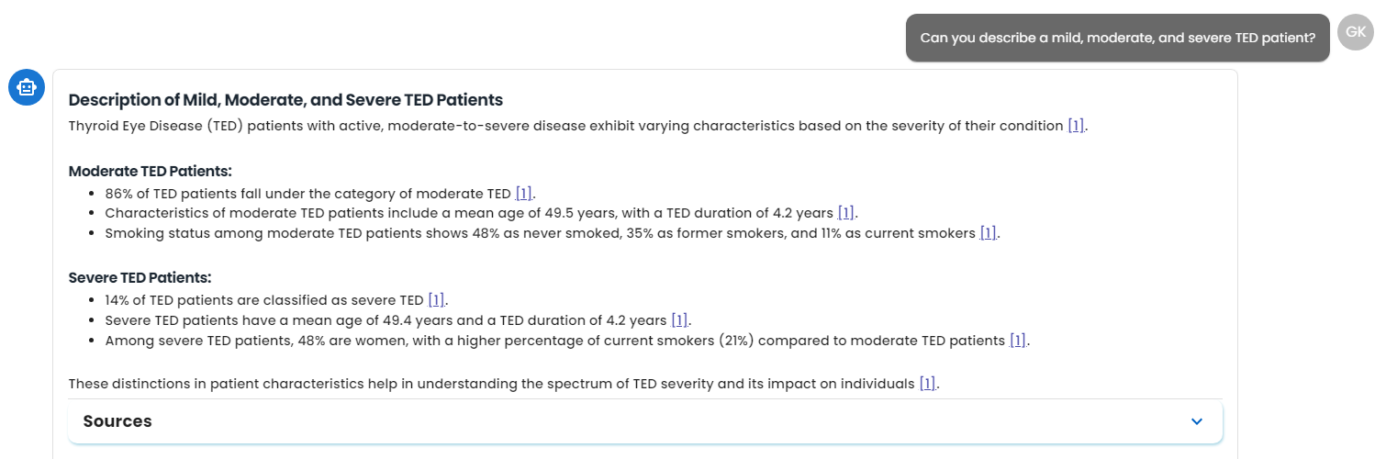
Response Improvisation Instances (2/4)
Old Architecture
New Architecture

Slide 12
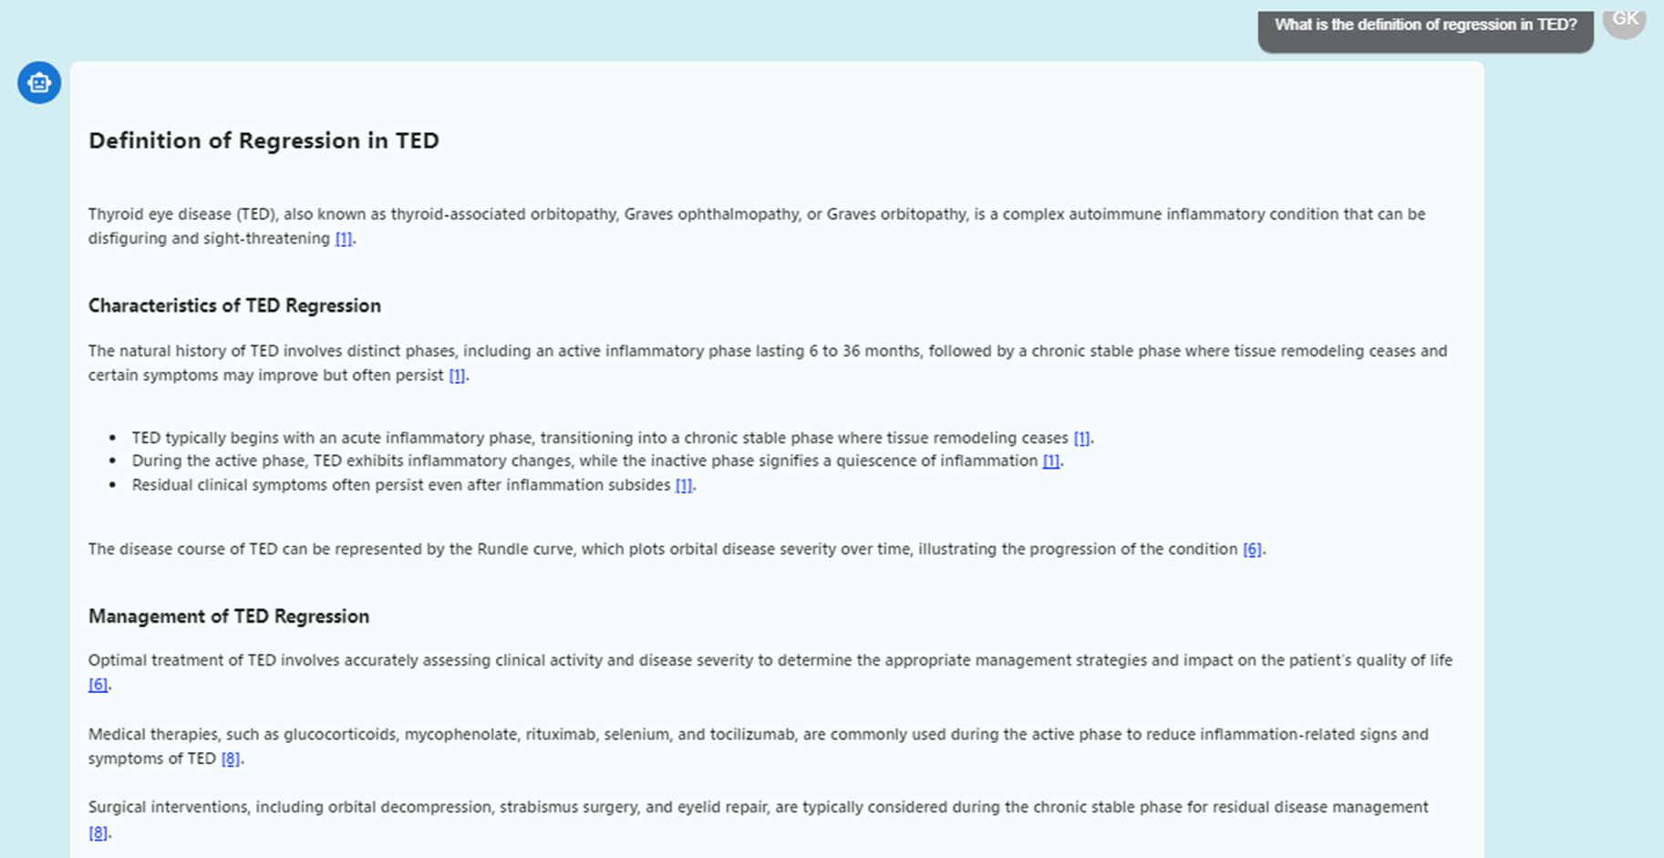
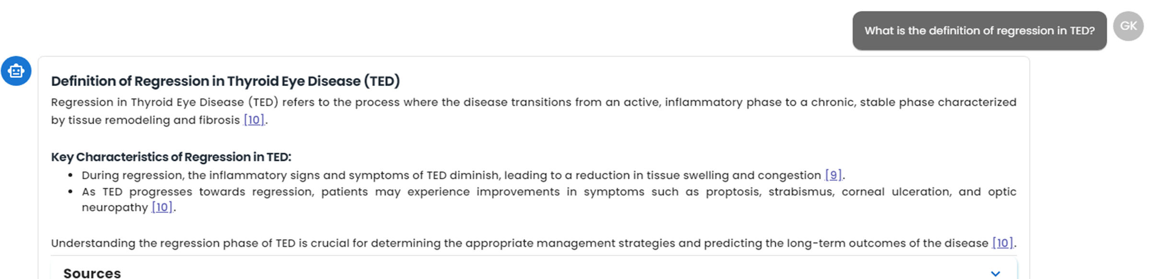
Response Improvisation Instances (3/4)
Old Architecture
New Architecture

Slide 13
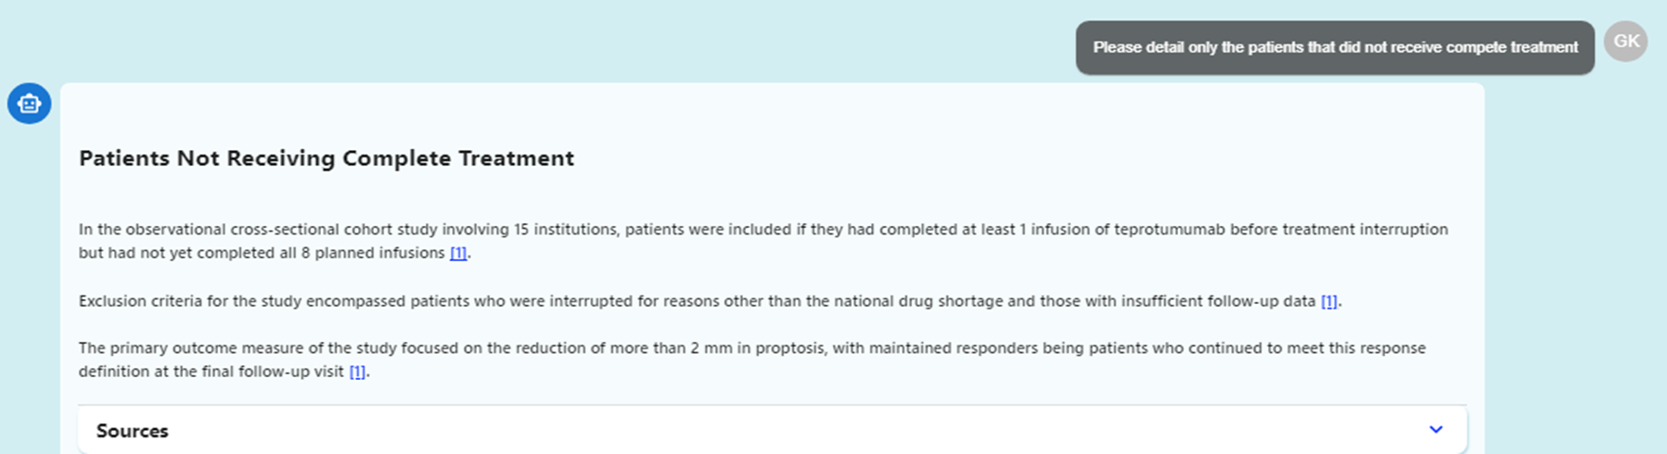
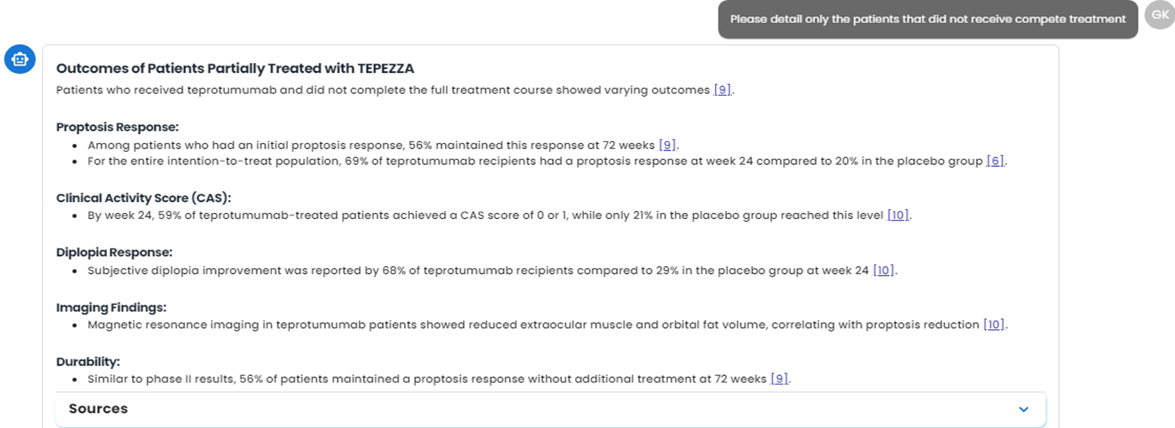
Response Improvisation Instances (4/4)
Old Architecture
New Architecture

Slide 14
Agenda
User Feedbacks
Resolved Issues with Latest Architecture
Issues with Examples
New architecture resolved the issue
Response Improvisation Instances
Issues which need to be worked on
Issues with examples
Root Cause Analysis & Solution
Need discussion with Medical Affairs Team on Feedbacks

Slide 15
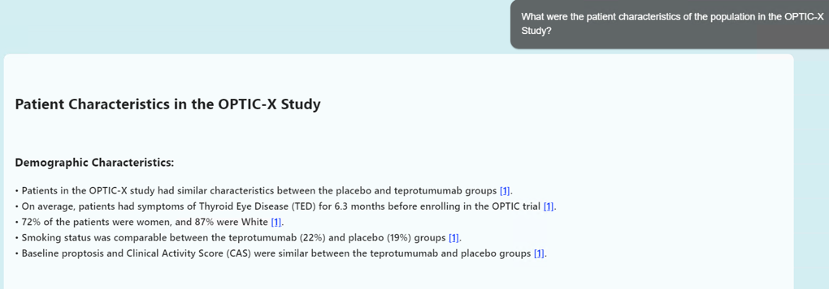
Issue which need to worked On– Example 1
User Comment
Problem Identified
The first part of this answer is not for OPTIC-X. It looks like it was for OPTIC.
Given responses are of different terminology which are similar words/extended words(like optic & optic-x );

Slide 16
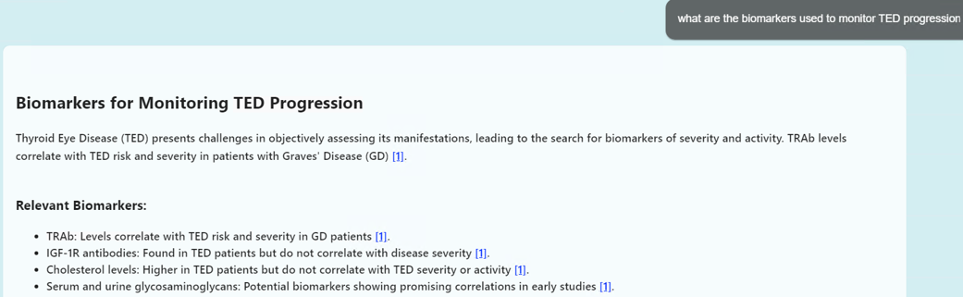
Example 2
User Comment
Problem Identified
Incorrect response generated
the content might not be available in knowledgebase
Incorrect response generated due to chunk searching
This answer is wrong

Slide 17
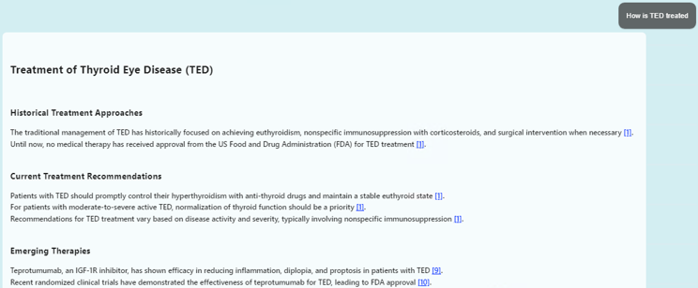
Example 3
User Comment
Problem Identified
EUGOGO is a good source for this response and should be included. Also the last response Preferred Therapeutic Option for Moderate-to-Severe TED is not relevant to this question.
Some points are not relevant
Few irrelevant pointers are coming in the response, which are due to lesser similarity score threshold

Slide 18




Root Cause Analysis & Solution
Area of improvement
Sematic search to Knowledge base
Select top 10 chunks
ReRanker - Reshuffling
Chunk 1
Chunk 5
Chunk 78
User Query
LLM Model
Chunk …
Chunk 13
Chunk 85
LLM Model
Knowledgebase
Chunk …
Chunk 20
Chunk 13
Chunk …
Chunk 78
Chunk 5
Final Response
Chunk 100
Chunk 85
Chunk 20
Solution
Improve the semantic search technique
Modifying the suitable similarity score threshold
Improve ranking technique

Slide 19
Agenda
User Feedbacks
Resolved Issues with Latest Architecture
Issues with Examples
New architecture resolved the issue
Response Improvisation Instances
Issues which need to be worked on
Issues with examples
Root Cause Analysis & Solution
Need discussion with Medical Affairs Team on Feedbacks

